Slide 1
GROUP 2
DHCP (Dynamic Host Configuration Protocol)

Slide 2
NEED FOR DYNAMIC ALLOCATION
IP address allocation is part of proper network design, which is crucial to the performance and expandability of a network.
When you define which IP addresses will be on which network, you are not only setting a precedent that will be difficult to change, you are limiting the size of your network. This is because IP networks/subnets have limited sizes.

Slide 3
Security– Static IP Address could be a security risk as the IP address is constant. There is a greater chance of hacking the website.
Configuration– The process to set a static IP is manual and relatively complex.
Keeping pace with technology– The field of computers is rapidly changing. It is possible that a static IP computer running a server becomes obsolete in the near future. It is relatively complex to transfer the server settings from a static IP computer to a new computer.

Slide 4
ADDRESS RESOLUTION PROTOCOL (ARP)
The address resolution protocol (ARP) is a protocol used by the Internet Protocol (IP), specifically IPv4, to map IP network addresses to the hardware addresses used by a data link protocol.
The protocol operates below the network layer as a part of the interface between the OSI network and OSI link layer.
ARP finds the hardware address, also known as Media Access Control (MAC) address, of a host from its known IP address.

Slide 5
ARP(Cont..)
ARP maintains a cache (table) in which MAC addresses are mapped to IP addresses.
Using the arp command allows you to display and modify the Address Resolution Protocol (ARP) cache.
ARP maps 32-bit logical (IP) address to 48-bit physical address.

Slide 6
REVERSE ADDRESS RESOLUTION PROTOCOL (RARP)
The Reverse Address Resolution Protocol (RARP) is an obsolete computer networking protocol used by a client computer to request its Internet Protocol (IPv4) address from a computer network, when all it has available is its link layer or hardware address, such as a MAC address.
RARP requires one or more server hosts to maintain a database of mappings of Link Layer addresses to their respective protocol addresses.
RARP maps 48-bit physical address to 32-bit logical (IP) address.

Slide 7
DRAWBACKS OF RARP
Since it operates at low level, it requires direct addresss to the network which makes it difficult for an application programmer to build a server.
It doesn't fully utilizes the capability of a network like ethernet which is enforced to send a minimum packet size since the reply from the server contains only one small piece of information, the 32-bit internet address.

Slide 8
BOOTSTRAP PROTOCOL (BOOTP)
BOOTP (Bootstrap Protocol) is a protocol that lets a network user be automatically configured (receive an IP address) and have an operating system booted (initiated) without user involvement.
The BOOTP server, managed by a network administrator, automatically assigns the IP address from a pool of addresses for a certain duration of time.
PORTS:
1. 67(UDP)server.
2. 68 (UDP) host.

Slide 9
DHCP
Dynamic Host Configuration Protocol (DHCP) is a client/server protocol that automatically provides an Internet Protocol (IP) host with its IP address and other related configuration information such as the subnet mask and default gateway.
Benefits of DHCP:
DHCP Server service provides the following benefits:
Reliable IP address configuration: DHCP minimizes configuration errors caused by manual IP address configuration, such as typographical errors, or address conflicts caused by the assignment of an IP address to more than one computer at the same time.
Reduced network administration: DHCP includes the following features to reduce network administration:
Centralized and automated TCP/IP configuration.
The ability to define TCP/IP configurations from a central location.
The ability to assign a full range of additional TCP/IP configuration values by means of DHCP options.

Slide 10
DHCP Architecture
DHCP contains:
DHCP clients
DHCP servers
DHCP relay agents on a network
Clients interact with servers using DHCP messages
To obtain and renew IP address leases.

Slide 11
DHCP Allocation Methods
Dynamic allocation
given IP address is revocable
IP address is given from a Pool (range of IP addresses) at the server
Automatic allocation
Same method is used in getting the address
Given IP address is never revoked
Manual allocation:
The address is allocated based on the user’s request
The address could be out of the DHCP allocated pool
Based on the identity of the node and the possibility of revoking the above methods differ.

Slide 12
BOOTP | DHCP
Designed prior to DHCP. | Designed after BOOTP.
Intended to configure diskless workstations with limited boot capabilities. | Intended to configure frequently relocated networked computers (such as portables) that have local hard drives and full boot capabilities
Dynamic BOOTP has a default 30-day expiration on IP address leases. | DHCP has a default eight-day expiration on IP address leases.
Supports a limited number of client configuration parameters called vendor extensions | Supports a larger and extensible set of client configuration parameters called options.
BOOTP clients do not rebind or renew configuration with the BOOTP server except when the system restarts | DHCP clients do not require a system restart to rebind or renew configuration with the DHCP server. Instead, clients automatically enter a rebinding state at set timed intervals to renew their leased address allocation with the DHCP server. This process occurs in the background and is transparent to the user.

Slide 13
Internet Protocol (IP) Address
IP address is a numerical unique address assigned to each device connected to a computer network that uses the Internet Protocol for communication.
IP address makes it easier for the computers to locate the server from anywhere in the world .
Static IP Address : Computer keeps a single IP address.
Dynamic IP Address : Network assigns the computer a new address each time it connects to the network.

Slide 14
IP Version
IP
IPv4
IPv6
IPv4 addresses are 32 bit length.
IPv4 addresses are represented in decimals.
DHCP is required to configure IPv4 addresses.
IPv4 addresses are 128 bit length.
IPv4 addresses are represented in hexadecimals.
Auto-configuration of addresses is available.

Slide 15
IPv4
IPv4 is a connectionless protocol for use on packet-switched networks.
It provides the logical connection between network devices by providing identification for each device.
This protocol works at the network layer of the OSI model and at the Internet layer of the TCP/IP model.
IPv4 uses 32-bit addresses which limits the address space to 4294967296 (2³²) addresses.
Example : 10.0.0.1

Slide 16
Classes and Subnet mask in IPv4
Class A : 0-127
Class B : 128-191
Class C : 192-223
Class D : 224-239
Class E : 240-255
255.0.0.0
255.255.0.0
255.255.255.0
N/A
N/A

Slide 17
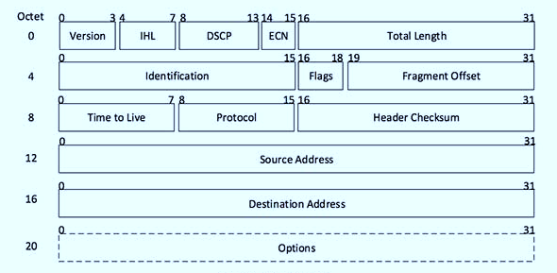
IPv4 Header Format

Slide 18
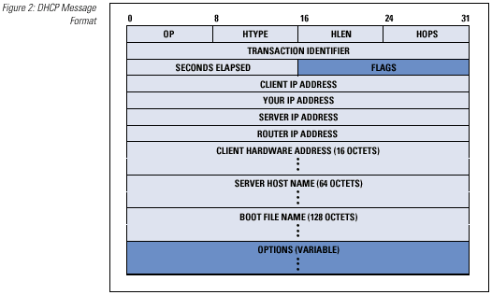
DHCP header
Operation code: This is 8-bit field defines the type of DHCP packet.
Hardware type: Defines the type of Physical network.
Hardware length: defines the length of the physical address in bytes.
Hop count: Defines the maximum number of hops the packet can travel.
Transition ID: The transaction Identification is set by the client and is used to match a reply with the request.
Number of seconds: The number of seconds elapsed since the time the client started to boot.
Flag: Flag is in which only the left most bit is used and the rest of its bits should be 0s. It specifies a forced broadcast reply from the server.
Client IP address: If the client does not have this information, this field will be 0.
Your IP address: it is filled by the server at request of the client.
Server IP address : It is filled by the server in a reply message.
Gateway IP address: It is IP address of the router. It is filled by the server in a reply message.
Client hardware address: this is a physical address of the client. It should be unique.
Server name: It is filled by server in a reply packet.
Boot file system: It should be a null terminated string.
Options (variable): For optional parameter.

Slide 19
DHCP Address Allocation Mechanism
The two main functions of the Dynamic Host Configuration Protocol are to provide a mechanism for assigning addresses to hosts, and a method by which clients can request addresses and other configuration data from servers.
DHCP standard includes three different address allocation mechanisms.
1) Manual Allocation
2) Automatic Allocation
3) Dynamic Allocation

Slide 20
Manual Allocation
Manual allocation is the simplest method, and is equivalent to the method BOOTP uses for address assignment.
Each device has an address that an administrator gives it ahead of time, and all DHCP does is look up the address in a table and send it to the client for which it is intended.
This technique makes the most sense for devices that are “mainstays” of the network, such as servers and routers.

Slide 21
Dynamic Allocation
An administrator sets up a pool (usually a range or set of ranges) of IP addresses that are available for use.
Each client that is configured to use DHCP contacts the server when it needs an IP address.
The server keeps track of which IP addresses are already assigned, and leases one of the free addresses from the pool to the client.
The server decides the amount of time that the lease will last. When the time expires, the client must either request permission to keep using the address (renewing the lease) or must get a new one.

Slide 22
Benefits Of Dynamic Allocation
Automation
Centralized Management
Address Reuse and Sharing
Portability and Universality
Conflict Avoidance

Slide 23
Automatic Allocation
It can be used in cases where there are enough IP addresses for each device that may connect to the network, but where devices don't really care what IP address they use.
Once an address is assigned to a client, that device will keep using it.
Automatic allocation can be considered a “special case” of dynamic allocation.
It is essentially dynamic allocation where the time limit on the use of the IP address by a client (the lease length) is forever.

Slide 24
Use Of MAC In DHCP
Enable and define an explicit allow list. The DHCP server provides DHCP services only to clients whose MAC addresses are in the allow list.
Enable and define an explicit deny list. The DHCP server denies DHCP services only to clients whose MAC addresses are in the deny list.
Enable and define an allow list and a block list. The block list has precedence over the allow list.
This means that the DHCP server provides DHCP services only to clients whose MAC addresses are in the allow list, provided that no corresponding matches are in the deny list.

Slide 25
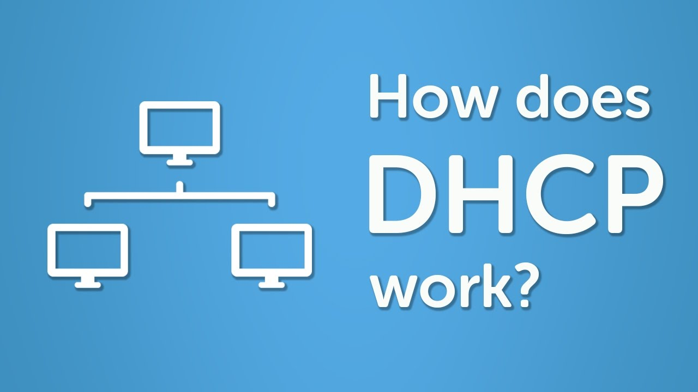

Slide 26

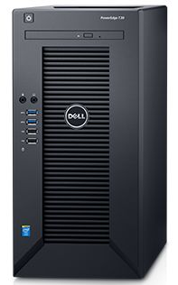
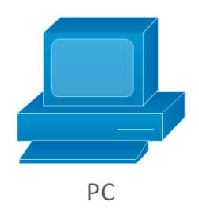
Step 4. DHCP server assign IP address and make sure that allotted IP is not used by any other client in network ,after confirmation it send DHCP ACK or else it will send DHCP NAK
Step 3. Client can receive multiple offer , it will choose one DHCP server and this is notified by DHCP Request message.
Step 1.Client will broadcast DHCP Discover packets in network
Steps 2. DHCP Server will send DHCP Offer which contains IP address offered by DHCP server.
Where is DHCP?
New DHCP CLIENT
DHCP Request
MAC Address
IP Addresses
DHCP ACK
DHCP CLIENT
DHCP RELAY AGENT
DHCP SERVER
DHCP CLIENT

Slide 27
DORA Process
Discovery
Offer
Request
DHCP CLIENT
ACK
DHCP SERVER

Slide 28
STEP BY STEP PROCESS OF DHCP
A device (the client) requests an IP address from a router (the host), after which the host assigns an available IP address to allow the client to communicate on the network.
Once a device is turned on and connected to a network that has a DHCP server, it will send a request to the server, called a DHCPDISCOVER request.
After the DISCOVER packet reaches the DHCP server, the server attempts to hold on to an IP address that the device can use, and then offers the client the address with a DHCPOFFER packet.

Slide 29
Once the offer has been made for the chosen IP address, the device responds to the DHCP server with a DHCPREQUEST packet to accept it.
After which the server sends an ACK that's used to confirm that the device has that specific IP address and to define the amount of time that the device can use the address before getting a new one.
If the server decides that the device cannot have the IP address, it will send a NACK.

Slide 30
Any Questions?

Slide 31
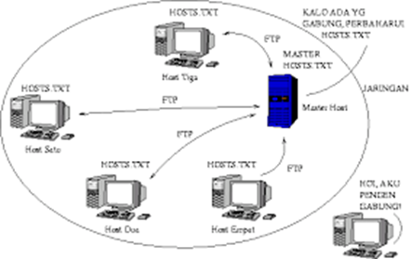
DNS History
APARANET utilized a central file HOST.txt.
Contains name’s to address mapping.
Maintained by SRI’s NIC (Stanford-Research-Institute: Network –
Information -Center)
Administrators email changes to NIC.
NIC updates HOSTS.txt periodically.
Administrators FTP (Download) HOSTS.txt.

Slide 32
DNS HISTORY Cont….
As the system grew, HOSTS.txt had problems with
Scalability ( Traffic and load)
Name collisions
Consistency.
In 1984, Paul Mockapetris released the first version (RFCs882 and 883,
superseded by 1034 and 1035….)

Slide 33
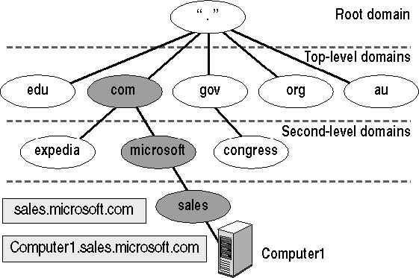
DNS Hierarchy
DNS uses a hierarchy to manage its distributed database system. The DNS hierarchy, also called the domain name space, is an inverted tree structure, much like eDirectory.

Slide 34
Top-Level Name Component of the DNS Hierarchy
Top-Level Name Component | Description | Example DNS Domain Name
.com | An Internet name authority delegates portions of the domain namespace under this level to commercial organizations, such as the Microsoft Corporation. | microsoft.com
.edu | An Internet name authority delegates portions of this domain namespace to educational organizations, such as the Massachusetts Institute of Technology (MIT). | mit.edu
.gov | An Internet name authority delegates portions of this domain namespace to governmental organizations, such as the White House in Washington, D.C. | whitehouse.gov
.org | An Internet name authority delegates portions of this domain namespace to noncommercial organizations, such as the Center for Networked Information Discovery and Retrieval (CNIDR). | cnidr.org
.net | An Internet name authority delegates portions of this domain namespace to networking organizations, such as the National Science Foundation (NSF). | nsf.net

Slide 35
Root Hints
Root hints are DNS data stored in a DNS server. The root hints provides a list of preliminary resource records that can be used by the DNS service to locate other DNS servers that are authoritative for the root of the DNS domain namespace tree.
Root hints are used to prepare servers authoritative for non-root zones so that they can learn and discover authoritative servers that manage domains located at a higher level or in other subtrees of the DNS domain namespace.
These hints are essential for servers authoritative at lower levels of the namespace when locating and finding servers under these conditions.
By default, the DNS Server service implements root hints using a file, named Cache.dns, stored in the %systemroot%\System32\Dns folder on the server computer.

Slide 36
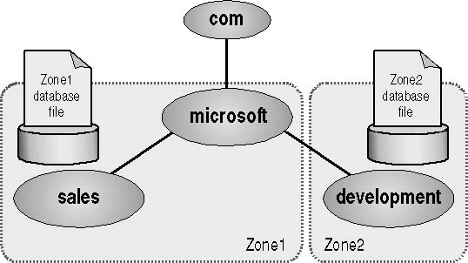
Zone Resolution
A zone represents a discrete portion of the domain namespace. Zones provide a way to partition the domain namespace into manageable sections and they provide the following functions:
Multiple zones in a domain namespace are used to distribute administrative tasks to different groups.

Slide 37
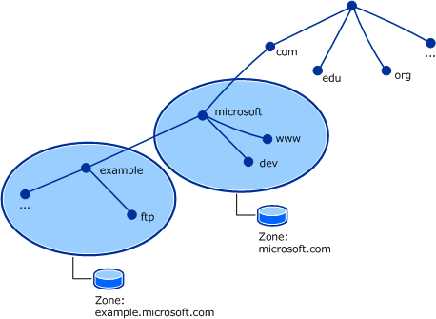
What is a DNS Zone ?
Every domain name, which is a
part of the DNS system, has
several DNS settings, also known
as DNS records ,to keep this DNS
records in order, the DNS zone
was created.
Each DNS zone represents a
boundary of authority subject to
management by certain entities.

Slide 38
Types of DNS Zones
There are 3 types of DNS Zone.
Primary DNS Zone
Secondary DNS Zone
Stub DNS Zone

Slide 39
Primary DNS Zone
Primary DNS Zone contain a read/write copy of the zone data.
All the DNS records added manually or automatically, are written in
this Primary zone of the DNS server
The data is stored in a standard text file – .txt.
Something essential is that to be able to make changes to the DNS
zone, the Primary zone must be available.

Slide 40
Secondary DNS Zone
The Slave zone is a read-only copy of the zone data.
The secondary DNS zone can receive the updated records only from
the primary DNS zone of the DNS server.
Secondary DNS zone can be used as a back up.

Slide 41
Stub DNS Zone
A stub zone is also read-only like a secondary zone, so
administrators can't manually add, remove, or modify resource records on it.
But the differences end here, as stub zones are quite different from secondary
zones in a couple of significant ways.
First, while secondary zones contain copies of all the resource records in the corresponding zone on the master name server, stub zones contain only three kinds of resource records:
A copy of the SOA record for the zone.
Copies of NS records for all name servers authoritative for the zone.
Copies of A records for all name servers authoritative for the zone.

Slide 42
DNS RECORDS
It is database record that maps a URL to an IP address
It contains the basic information of all elements of a domain system.
Each record has a type, an expiration time, class.
There are different types of records used in DNS. Most commonly used records are:
1. A/AAAA
2.CNAME
3.PTR

Slide 43
A/AAAA:
A/AAAA is used to translate domain names into IP address.
A is used to specify the IPV4 address and AAAA is used to specify the IPV6 address
EX:
Example.com A 12.30.56.96
Example.com AAAA 0123:4567:89ab:cdef:0123:4567:89ab:cdef

Slide 44
2.CNAME: (Canonical NAME)
It is used for creating alias names for the domains.
CNAME record should not be used for a domain that gets a mail, as the mail server deals it with in an odd manner.
MX records cannot refer to CNAME_ defined hostnames.
Ex:
bar.example.com. CNAME foo.example.com.

Slide 45
PTR(Pointer Record)
It is used to translate IP address to domain name, by reverse DNS lookup.
As a prerequisite to create a PTR record , we need to create a valid A/ AAAA record that points to desired domain of that IP.

Slide 46
Iterative resolution
client sends query to 1st server if server is authorized to
domain name it sends answer otherwise send IP address of next
server who can resolve query. Now here client sends query to 2nd
server .Client continues this process of sending query to server until
query is resolved.
In recursive client only send query to 1st server then server will send request to next server until query is resolved.
In iterative client is responsible for sending query to different servers until query is resolved.

Slide 47
Recursive resolution
A recursive query is a kind of query, in which the DNS server, who received your query will
do all the job of fetching the answer, and giving it back to you. During this process, the DNS
server might also query other DNS server's in the internet on your behalf, for the answer.

Slide 48
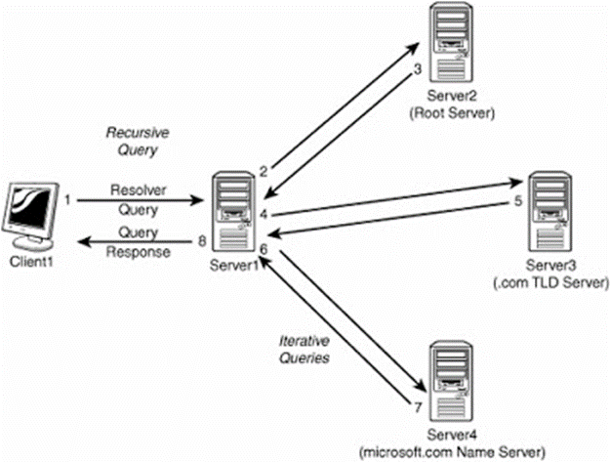
DNS server which keeps all root zone is called TLD name server.

Slide 49
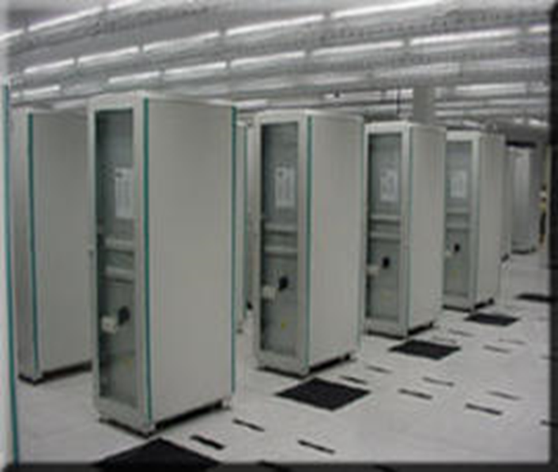
A root server
Located in Amsterdam, , the Netherlands
198.41.0.4 – IPV4
2001:503:ba3e::2:30 – IPV6

Slide 50

B root server
Located in Budapest, Hungary
199.9.14.201 – IPV4
2001:500:200::b – IPV6

Slide 51

C root server
Located in Paris, France
192.33.4.12 – IPV4
2001:500:2::c – IPV6

Slide 52

D root server
Located in London, United Kingdom
199.7.91.13 – IPV4
2001:500:2d::d – IPV6

Slide 53
E root server
Located at Boston, US
192.203.230.10 – IPV4
2001:500:a8::e – IPV6

Slide 54

F root server
Located at Melbourne, Victoria, Australia
192.5.5.241 – IPV4
2001:500:2f::f – IPV6

Slide 55
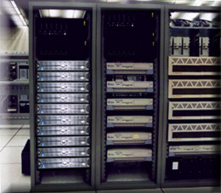
G root server
Located at Chicago, Illinois, USA
192.112.36.4 – IPV4
2001:500:12::d0d – IPV6

Slide 56
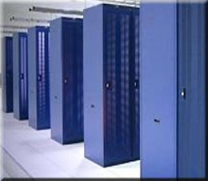
H root server
Located at Des Moines, Iowa, USA
198.97.190.53 – IPV4
2001:500:1::53 – IPV6

Slide 57

I root server
Located at Chennai, Tamilnadu, India
192.36.148.17 – IPV4
2001:7fe::53 – IPV6

Slide 58
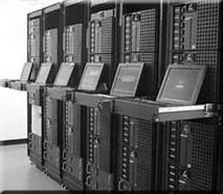
J root server
Located at Singapore
192.58.128.30 – IPV4
2001:503:c27::2:30 – IPV6

Slide 59
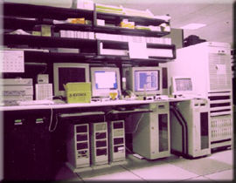
K root server
Located at Moscow, Russia
193.0.14.129 – IPV4
2001:7fd::1 – IPV6

Slide 60
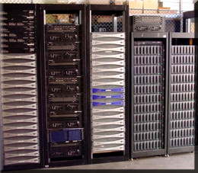
L root server
Located at Tehran, Iran
199.7.83.42 – IPV4
2001:500:9f::42 – IPV6

Slide 61
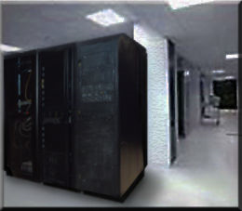
M root server
Located at Chimbote, Peru
202.12.27.33 – IPV4
2001:dc3::35 – IPV6

Slide 62
Working of DNS
Website Request
Ask resolver
Ask root server
Ask TLD server
Ask authoritative name servers
Cache the IP and return it to the browser

Slide 63
DIRECTORY SERVICES
LDAP

Slide 64
Mohammed Asik - 093947
Raavi Vinay Kumar - 093992
Madhuri Sanapala - 093963
Rohit Hurkadli - 094048
Bindu Shree - 093941
Priyal Potnis - 093979
Subham - 093988

Slide 65
X.500 Directory Service
The X.500 directory service is a global directory service.
X.500 is a series of computer networking standards covering electronic directory services.
The X.500 series was developed by CCITT, and first approved in 1988.
Its components cooperate to manage information about objects such as countries, organizations, people, machines, and so on in a worldwide scope.
It provides the capability to look up information by name and to browse and search for information.

Slide 66
The different types of protocols of X.500:
DAP (Directory Access Protocol)
DSP (Directory System Protocol)
DISP (Directory Information Shadowing Protocol)
DOP (Directory Operational Bindings Management Protocol)
These protocols used in the OSI networking stack.
A number of alternatives to DAP were developed to allow Internet clients to access the X.500 Directory using the TCP/IP networking stack.
The most well-known alternative to DAP is Lightweight Directory Access Protocol (LDAP).

Slide 67
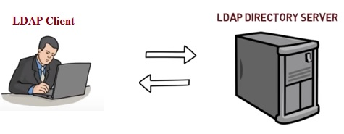
LDAP (Lightweight Directory Access Protocol)
Lightweight Directory Access Protocol uses client-server architecture.
It is used to manage and access distributed directory over IP network.
It is similar to telephone directory containing contact numbers and addresses of the subscribers.
It provides directory service with systematic set of records organized in hierarchical structure.

Slide 68
LDAP (contd..)
Clients may be directly controlled by individuals, embedded in applications or "agents".
It is useful when integrating multiple directory services.
To commence LDAP session, client needs to connect with server (called as "Directory System Agent").
After connection is established, client and server can exchange the information or data.
Various operations can be performed on LDAP such as Add, Bind, Delete, Modify, Unbind etc.
The default TCP port for LDAP is 389

Slide 69
Basic functionality of LDAP
The main benefit of using LDAP is that information for an entire organization can be consolidated into a central repository.
For example, rather than managing user lists for each group within an organization, LDAP can be used as a central directory accessible from anywhere on the network. And because LDAP supports Secure Sockets Layer (SSL) and Transport Layer Security (TLS), sensitive data can be protected from prying eyes.

Slide 70
Advantages of LDAP
Global naming model ensures unique entries.
It allows use of multiple independent directories.
It is extensible to meet future/local requirements.
It runs over TCP/IP and SSL directly.
It has wider support across the industries.
The protocol is based on existing deployed technologies.
LDAP is used by many services like TCP and DNS.
It is open source protocol with very flexible architecture.
LDAP is automated and hence updating of the same is much easier unlike DNS.

Slide 71
Disadvantages of LDAP
It requires directory servers to be LDAP compliant for service to be deployed.
LDAP is difficult but rarely employed unlike DNS which is more easy to use and widely employed.
An LDAP server cannot be its own client.
Setting up and managing an LDAP naming service is more complex and requires careful planning

Slide 72
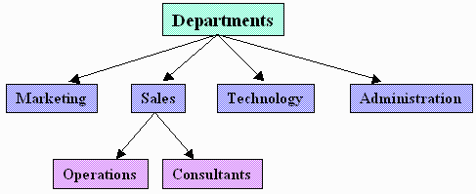
DIRECTORY STRUCTURE
The primary purpose of the directory services is to provide systematic set of records usually organized in a hierarchical structure.
9

Slide 73
Root Node
Branch Node
Leaf Nodes

Slide 74
EXAMPLE.COM
IT
sales
Micheal Yee
Rick Francis
DN Kulkarni
W cooley
J Jones

Slide 75
LDAP Directory Structure
An LDAP directory has a tree structure.
All entries (called objects) of the directory have a defined position within this hierarchy.
This hierarchy is called the directory information tree (DIT).
12

Slide 76
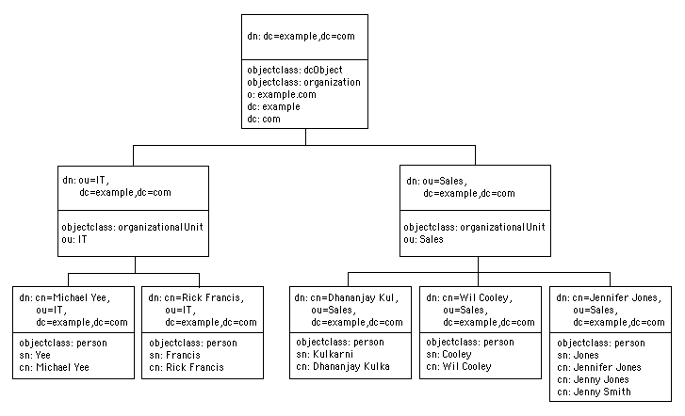
Directory Information Tree (DIT)

Slide 77
OPERATIONS OF LDAP
Add operation:
Used to create a new entry in a directory server.
Bind operation:
Used to authenticate a user and change the identify of the associated connection.
Modify operation:
Used to alter the contents of an entry in a directory server.
Delete operation:
Used to retrieve entries that match a provided set of criteria.
Unbind operation:
Used to close the connection to the directory server.

Slide 78
OPERATIONS OF LDAP(contd..)
Abandon operation:
An abandon operation may be used to request that the server stop working on an operation that the client had previously requested.
Compare operation:
The Compare operation allows a client to request the comparison of an entry attribute against a specific value.
Extended operation:
The Extended operation allows a client to request an operation that may not be defined in the current RFCs but is available on the server.
Search operation:
The Search operation is used to request a server to return, subject to access controls and other restrictions, a set of entries matching a search filter.
Modify DN operation:
The ModifyDN operation allows a client to change the Relative Distinguished Name (RDN) of an entry or to move an entry in the LDAP directory. 15

Slide 79
Configuring LDAP on windows 2012 server

Slide 80
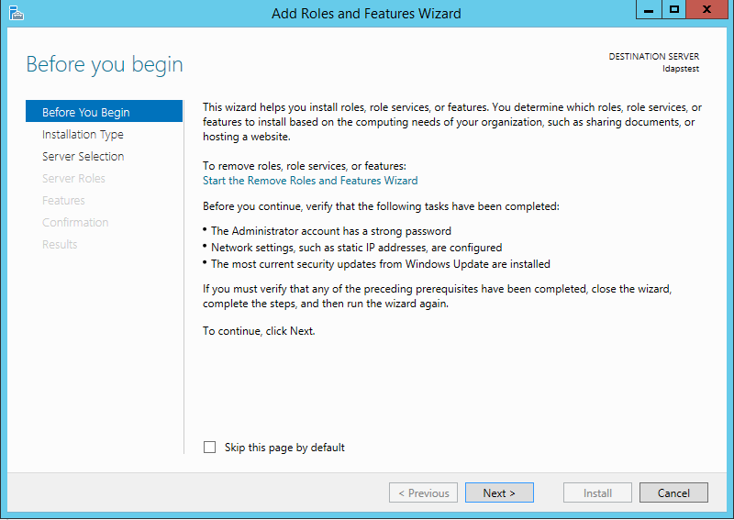
Click on Start --> Server Manager --> Add Roles and Features. Click Next.

Slide 81
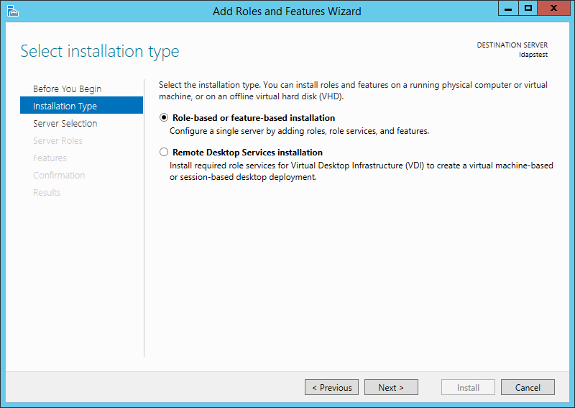
Choose Role-based or feature-based installation. Click Next.

Slide 82
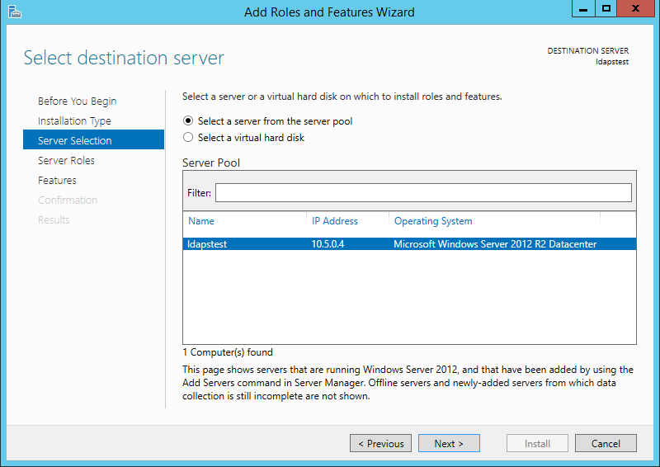
Select ldapstest server from the server pool. Click Next.

Slide 83
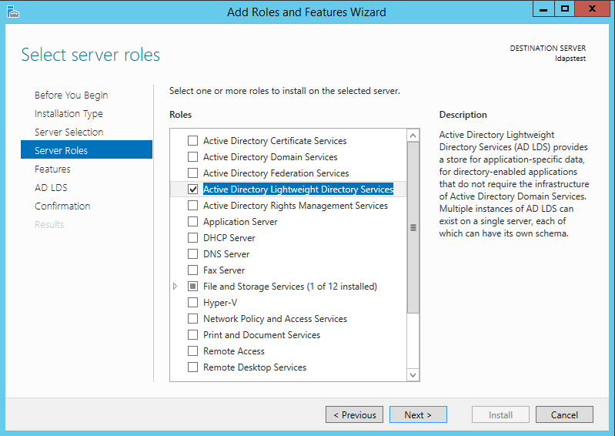
Mark Active Directory Lightweight Directory Services from the list of roles and click Next.

Slide 84
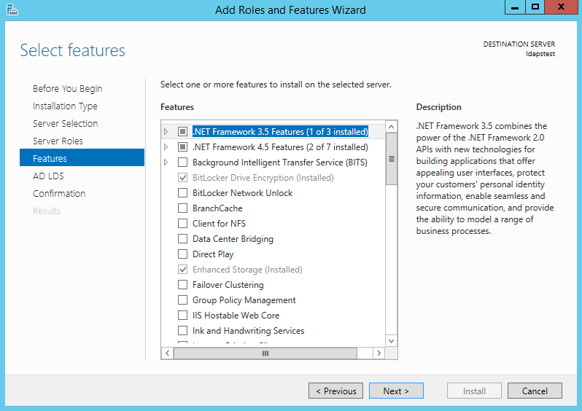
From the list of features, choose nothing – just click Next.

Slide 85
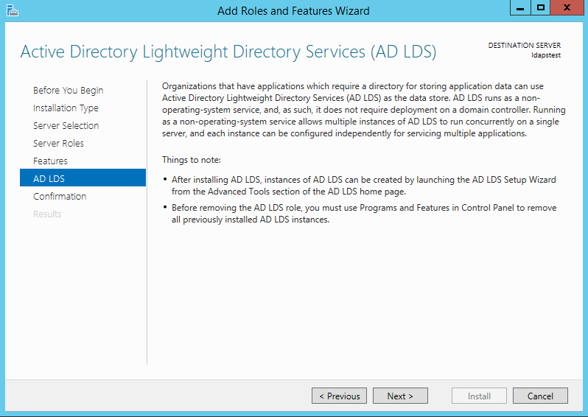
Click Next.

Slide 86
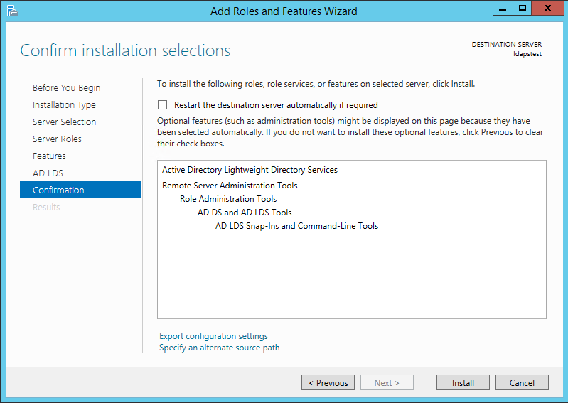
Click Install to start installation.

Slide 87
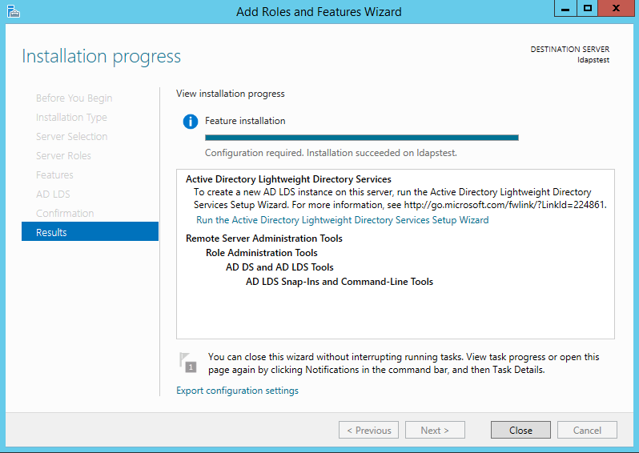
Once installation is complete, click Close.

Slide 88
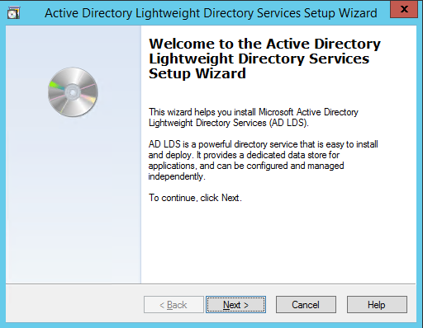
Now we have successfully set up AD LDS Role. Let us create a new AD LDS Instance “CONTOSO” using the wizard.
Click the “Run the Active Directory Lightweight Directory Services Setup Wizard” in the above screen. And then Click Close.

Slide 89
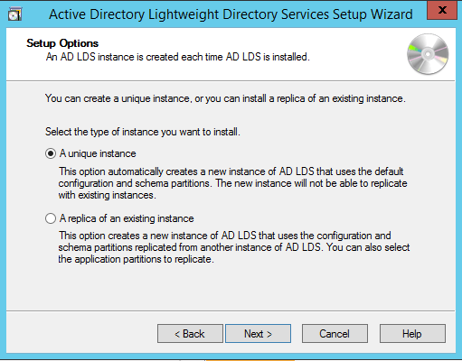
Choose Unique Instance since we are setting it up for the first time.

Slide 90
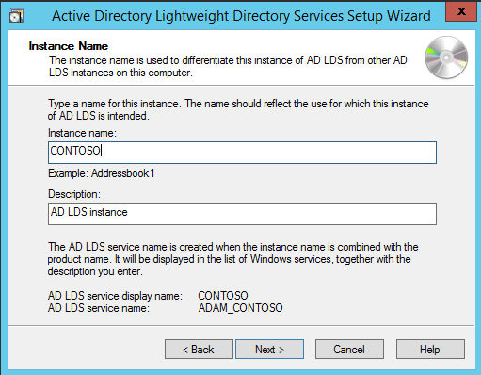
Type “CONTOSO” in Instance Name and click Next.

Slide 91
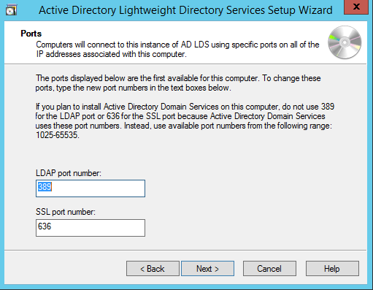
By Default, LDAP Port is 389 and LDAPS port is 636, let us choose the default values - click Next.

Slide 92
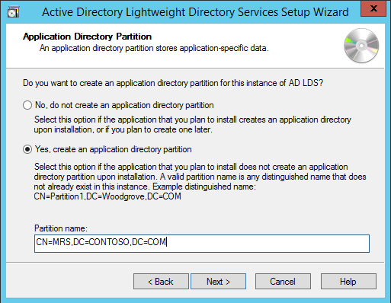
Create a new Application Directory Partition named “CN=MRS,DC=CONTOSO,DC=COM”. Click Next..

Slide 93
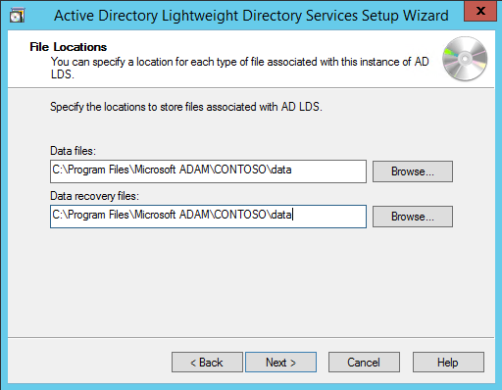
Using the default values for storage location of ADLDS files- Click Next.

Slide 94
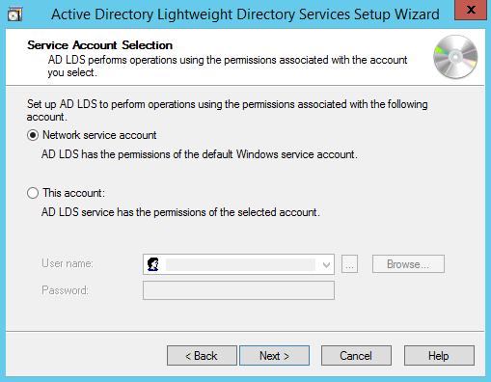
Choosing Network Service Account for running the AD LDS Service.

Slide 95
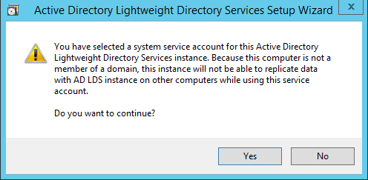
You will receive a prompt warning about data replication. Since we are using a single LDAP Server, we can click Yes.

Slide 96
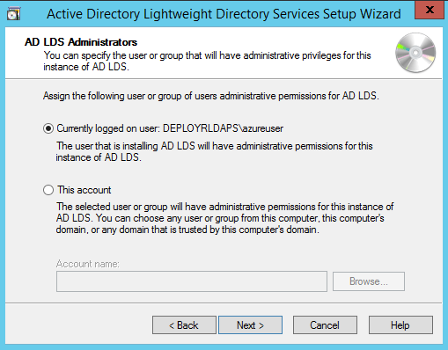
Choosing the currently logged on user as an administrator for the AD LDS Instance. Click Next.

Slide 97
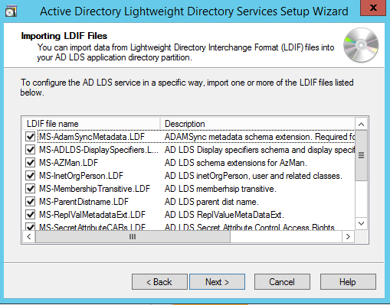
Mark all the required LDIF files to import (Here we are marking all files). Click Next

Slide 98
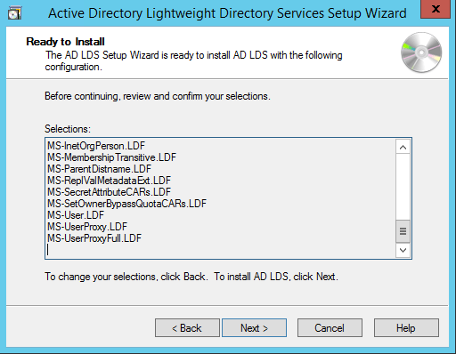
Verify that all the selections are right and then Click Next to confirm Installation.

Slide 99
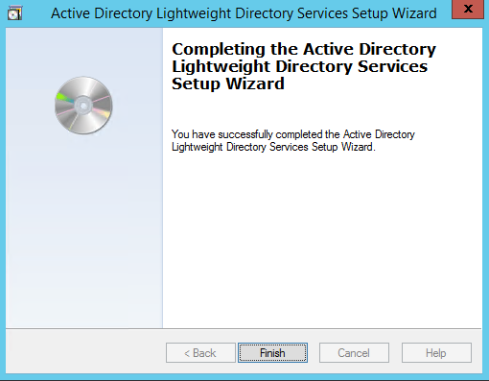
Once the instance is setup successfully, click Finish.

Slide 100
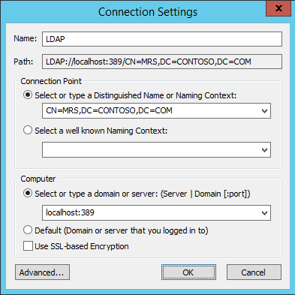
Now let us try to connect to the AD LDS Instance CONTOSO using ADSI Edit. Click on Start --> Search “ADSI Edit” and open it. Right Click on ADSI Edit Folder (on the left pane) and choose Connect To.. . Fill the following values and Click OK

Slide 101
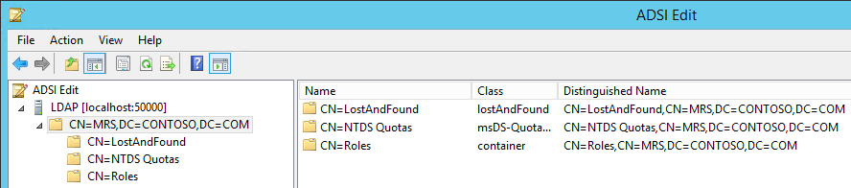
If the connection is successful, we will be able to browse the Directory CN=MRS,DC=CONTOSO,DC=COM :

Slide 102
MAIL SERVER
GROUP 2
30/3/2018

Slide 103
GROUP MEMBERS
Menaga -093959
Navya Rani* -093953
Paila Sujana -094001
Ayub Nadaf -094047
Prem Singh Rawat -093999
Mohammad Abdul Jabbar -093958
Raj Subash B -093964

Slide 104


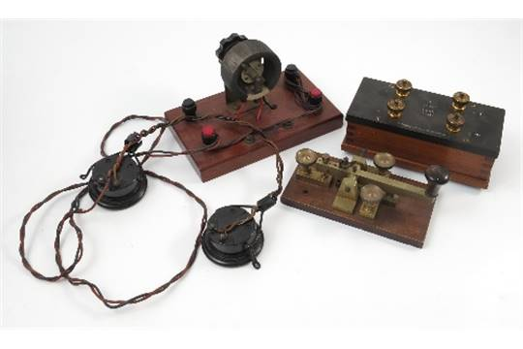
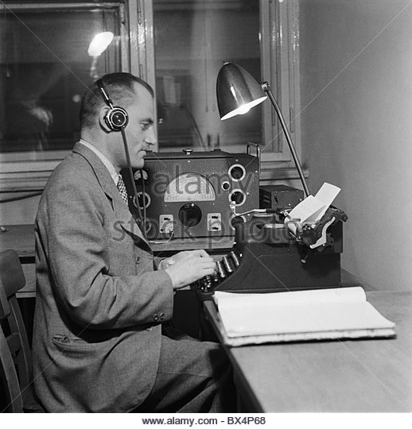
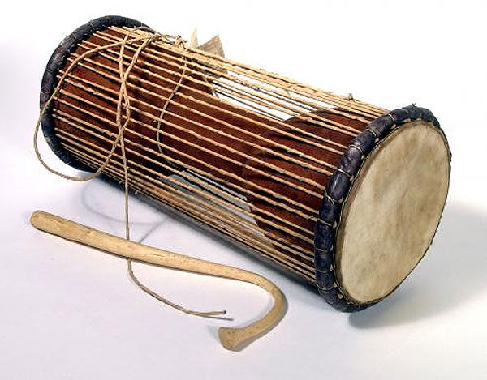


Slide 105

E-MAIL
Electronic Mail (email or e-mail) is a method of exchanging messages ("mail") between people using electronic devices.
Email first entered limited use in the 1960s and by the mid-1970s had taken the form now recognized as email.
Email operates across computer networks, which today is primarily the Internet.
The first e-mail was sent by Ray Tomlinson in 1971.

Slide 106


E-MAIL & POSTAL MAIL
E-MAIL
POSTAL MAIL
E-mail takes few seconds to deliver the message all around the world.
E-mail costs just the cost of a local phone call.
A carbon copy of mail can be sent to the other people.
E-mail passed from one computer to other over the network.
Rate independent of quality and data type.
According to Law, an e-mail is considered as legal.
They may take longer time 4 to 5 days depending on the destination.
Costs depends on the national and international tariff rates.
Different envelops are needed to send the same message to many people.
This stops at different postal stations which comes on the way.
Rate depends on the weight of mailing document and destination.
Postal mail documents are valid proofs and also legal.

Slide 107
E-MAIL ONLINE:
The way of sending and receiving e-mail is an online e-mail service or webmail.
Examples: Hotmail (now Outlook.com), Gmail, and Yahoo Mail.
The “To” field is that where you send the e-mail address of the person and “From” shows your e-mail address.
The Subject should consist of few words describing the e-mails content and it represent what the e-mail is about without opening and reading the full e-mail.
Cc (Carbon Copy) - Put the email addresses here if you are sending a copy for their information (and you want everyone to explicitly see this).
Bcc (Blind Carbon Copy) - Put the email address here if you are sending them a Copy and you do not want the other recipients to see that you sent it to this contact.
Finally, the Message Body is the location you type your main message. It often contains your signature at the bottom; similar to a hand-written letter.

Slide 108
WHY WE USE E-MAIL:
We can send message anytime anywhere.
E-mail is in written, you can compose and review your message before sending.
We can send and forward the same message to several people at same time around the world.
We can save the time, E-mail is very fast, usually take very less time to receive.
You may attach files, documents, images, & other media to an email.
You can access your email from anywhere with Internet connection kept on.
It allows to save & keep a record of your communication.

Slide 109
MUA(MAIL USER AGENT)
The Mail User Agent (MUA) is an application which is used to compose, send, and receive emails.
Writes e-mail to MTA using SMTP (usually).
Reads e-mail delivered by MDA.
Examples: Mozilla Thunderbird, Outlook Express.
Format outgoing messages with proper header information and encode the outgoing messages for use by Mail Delivery Agents in routing the messages.
Allow users to read, save, and delete incoming electronic mail messages.
Schedule MIME Applications to allow the user to experience non-textual information attached to incoming electronic mail.
Example: Viewing graphics files or video clips, or listening to audio data.

Slide 110
MTA(MESSAGE TRANSFER AGENT)
MTA is a software application used within an Internet message handling system (MHS). It is responsible for transferring and routing an electronic mail message from the sender’s computer to the recipient’s computer.
The main function of the MTA is forwarding the incoming message to the proper end-user or destination. MTA is also known as mail relay.
The MTA’s operational activities are always performed on the back end, but a user is unaware of these because he or she will interact with an email client interface.
Some major functions of MTA :
Receiving all messages that are transmitted from other user agents for further transmission.
Keeping track of each and every activity and analyzing and storing the recipient list to perform future routing functions.
Sending auto-responses about non delivery when a message does not reach its intended destination.

Slide 111
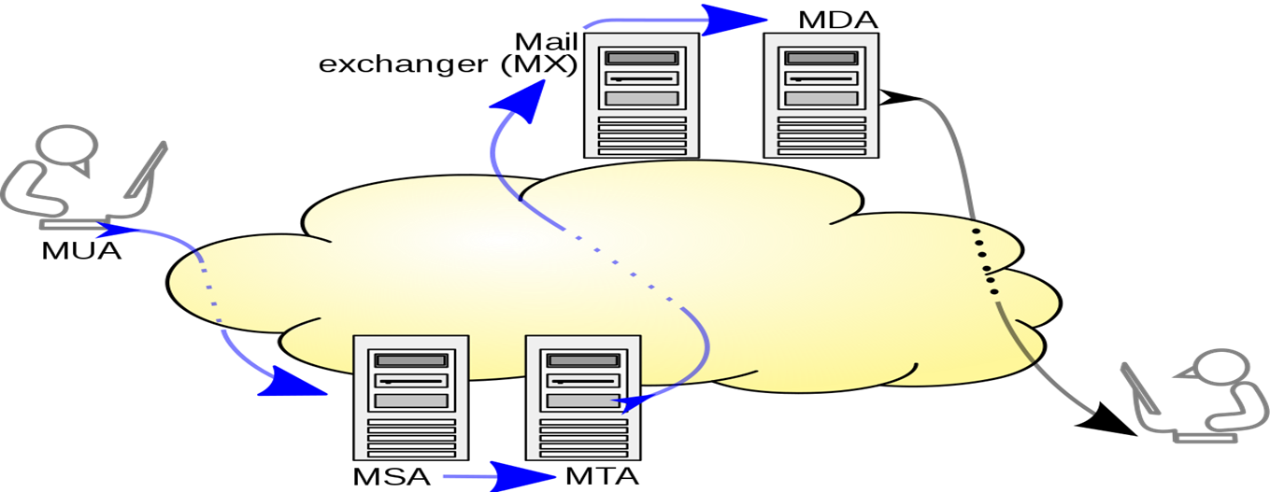
MDA / LDA
MDA is a Mail Delivery Agent (or) Message Delivery Agent and LDA is a Local Delivery Agent.
MDA is a computer software component that is responsible for the delivery of e-mail messages to a local recipient's(clients) mailbox.
Within a destination mail server, local MDA accepts an incoming email from remote MTA.
MDA’s do not transport messages between systems or interface only with the end user.
Delivers mail to other MTA.

Slide 112
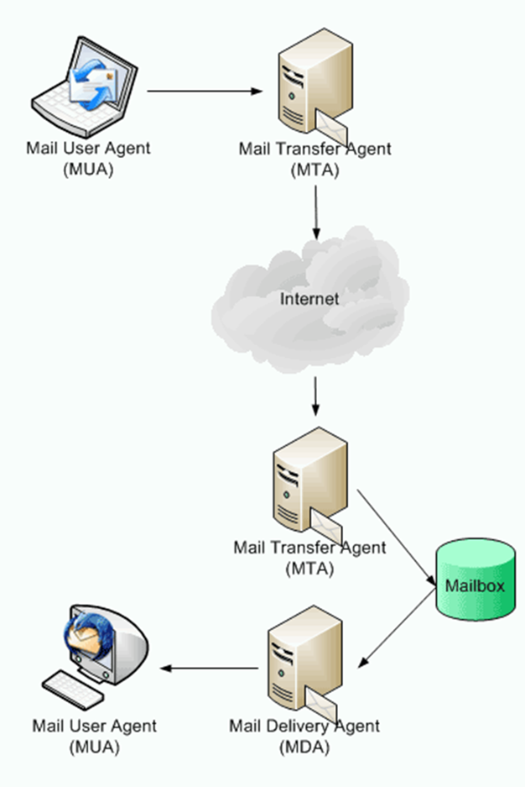
MDA/LDA
The recipient’s MTA receives the email and passes it on to a Mail Delivery Agent (MDA). An MDA manages the user’s mailbox and handles mails for delivery to the MUA using either the POP or IMAP protocol.
MDA Software
Proc mail
Mail drop
Dovecot
Postfix
Cyrus

Slide 113
SMTP
What is SMTP?
Simple Mail Transfer Protocol
SMTP server – every email client interfaces to send email
List of SMTP servers in transit - Check the headers on your email!
Port no:25

Slide 114
MULTIPART MESSAGES
But can we send multipart messages with attachments?
YES
SMTP is only a delivery mechanism, nothing to do with contents
Your assignment
Simple text

Slide 115
POP3
It is a simple protocol used for opening the remote e-mail boxes.
This protocol is defined in RFC 1225.
Post Office Protocol version 3 (POP3) is a message access protocol that enables the client to fetch an e-mail from the remote mail server.
A POP3 server stores messages for each user until the user connects to download and read them using a POP3 client

Slide 116
COMMANDS IN POP3
stat: It asks the server for the number of messages waiting to be retrieved.
list: It determines the size of each message to be retrieved.
retr: It retrieves individual messages .
Quit: Ends the POP3 session.

Slide 117
MAIL ACCESS BY POP3
The client POP3 software is installed on the receiver's computer the server POP3 software is installed on the mail server.
POP3 uses well-known TCP port 110.
The communication procedure is similar to SMTP and uses ASCII characters.
POP3 begins when user starts the mail reader.
The mail reader calls up the ISP (or mail server) and establishes a TCP connection with the message transfer agent at port 110.

Slide 118
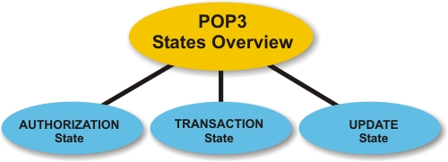
POP3 STATES

Slide 119
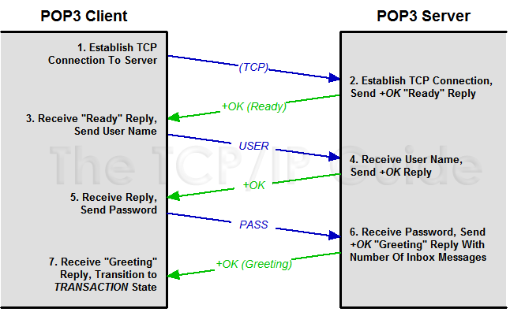
AUTHORIZATION STATE

Slide 120
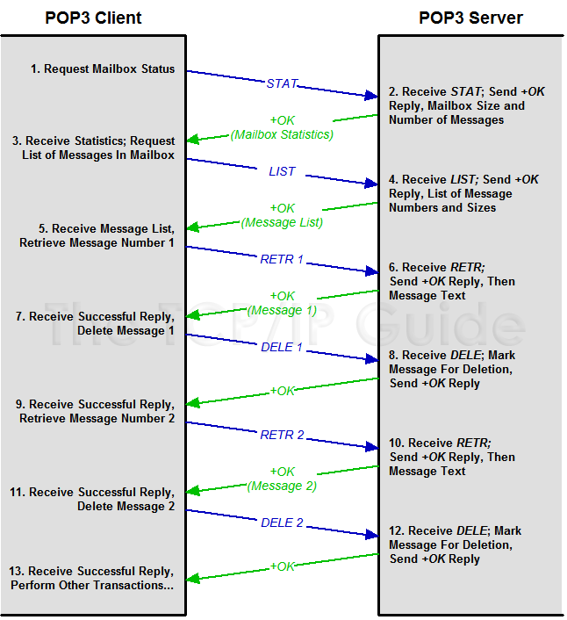
TRANSACTION STATE

Slide 121
UPDATION STATE
When the POP3 client is done with its e-mail transactions, it issues the QUIT command.
This causes the Update state to be automatically entered, where the server performs necessary clean-up operations, including deleting any messages marked for deletion in the Transaction state.

Slide 122
ABOUT IMAP
Internet Message access protocol.
1986, Stanford University.
It is used to access messages from more than one computer.
Port number is 143.
IMAP over SSL (IMAPS) is assigned the port number 993.
Used for accessing electronic mail that are kept on server.

Slide 123
IMAP4
Internet Message Access Protocol (IMAP) is an Internet standard protocol used by e-mail clients to retrieve e-mail messages from a mail server over a TCP/IP connection.
The Internet Message Access Protocol is an Application Layer Internet protocol that allows an e-mail client to access e-mail on a remote mail server.
IMAP supports both on-line and off-line modes of operation. E-mail clients using IMAP generally leave messages on the server until the user explicitly deletes them.

Slide 124
Multiple clients can talk to the same account on the same server – from anywhere
IMAP Server
IMAP Server
Clients can talk to multiple servers
Mail
folders
Mail
folders
IMAP client
IMAP client
Client has full control over their mail folders. Can create, delete or move them around – even between different accounts on different servers
Client decides where to store messages. Copy them locally or leave them on the server.
Mail
folders
Mail
folders

Slide 125
INTERACTION BETWEEN CLIENT AND SERVER
Client sends data – server receives:
Client command begins with alphanumeric string (‘tag ’) e.g. A001 which is created for every new command.
Then the command with corresponding arguments follows
Server sends data – client receives
Server receives and works with command
Return the same tag with a state (OK/NO/BAD)
Additional information begin with ‘*’ (untagged)
Untagged in formation can be sent at every time

Slide 126
ADVANTAGES OF IMAP4
You can keep a local archive, as well as rest assured knowing a copy is stored on the mail server.
With a persistent Internet connection, only email headers are downloaded, so you can see your mail faster. The full message is only downloaded when you request to read it.
Size of your message archive is limited only by your account’s server space, not your personal device(s).

Slide 127
MAPI
MAPI interface is required for interfacing messaging-based services to client applications such as Outlook.
For example, several non-Microsoft e-mail server product vendors created "MAPI service providers" to allow their products to be accessed via Outlook.
While MAPI is designed to be independent of the protocol, it is usually used with MAPI over HTTP or MAPI/RPC, protocols used by Microsoft Outlook communicate with Microsoft Exchange Server.

Slide 128


Slide 129
Alice
Bob
Reduced header
TO: Bob@dougj.com
Hello Bob
From:alice@iseag.com
Hello Bob
UA
UA
UA Header from:alice@iseag.com
MTA2 Header
MIME Header
MTA1 Header
Hello Bob
UA Header from:alice@iseag.com
MAT2 dougj.net
MIME Header
MAT iseage.net
SMTP
Internet
Hello Bob
MTA2 Header
MTA1 Header
MTA1 Header
UA Header from:alice@iseag.com
UA Header from:alice@iseag.com
MIME Header
MIME Header
Hello Bob
Hello Bob

Slide 130
THANK YOU

Slide 131
Proxy server
SLIDE NO: 1

Slide 132
TEAM MEMBERS
NANDINI N
ARVETHI NAVEEN 093939
DIVYASHREE V 093950
MAHANTHESH KUMBAR 093957
SANDEEP N V S DIVVELA 093949
SAI KRISHNA
MONISHA S M 093952
SLIDE NO: 2

Slide 133
SLIDE NO: 3
Proxy Server
A proxy server is a dedicated computer or a software system running on a computer that acts as an intermediary between an endpoint device, such as a computer, and another server from which a user or client is requesting a service.
Functionalities:
Firewall and network data filtering.
Network connection sharing.
Data caching.
Types of proxies :
Forward proxy.
Open proxy.
Reverse proxy.

Slide 134

Forward Proxy
SLIDE NO: 4

Slide 135

Open Proxy
SLIDE NO: 5

Slide 136

Reverse Proxy
SLIDE NO: 6

Slide 137

Architecture
SLIDE NO: 7

Slide 138

PING (Packet Internet Groper)
It is TCP/IP utility used to troubleshoot the Network issues.
You can run the ping command on a Windows computer by opening an MSDOS window and then typing "ping" followed by the domain name or IP address of the computer you wish to ping. You can list the available options for the Windows ping command with "ping -?".
SLIDE NO: 8

Slide 139
Ping Results
Successful Ping Results:
PING www.asite.com (135.9.4.93) from 135.9.77.30 : 56 (84) bytes of data.
64 bytes from www.asite.com (135.9.4.93): icmp_seq=0 ttl=245 time=6.3 ms
64 bytes from www.asite.com (135.9.4.93): icmp_seq-1 ttl=245 time=6.3 ms
2 packets transmitted, 2 packets received, 0% loss
round-trip min/avg/max = 0.3/3.3/6.3 ms
SLIDE NO: 9

Slide 140
Unsuccessful Ping Results:
The network or the network host is down.
The host is denying the packets.
The ping was sent to the wrong address.
Packets are rejected. The host may have been optioned not to respond to incoming ICMP packets.
Packets did not reach the host. A network problem is preventing the ping packets from reaching the host.
SLIDE NO: 10

Slide 141

ICMP
The Internet Control Message Protocol (ICMP) is a supporting protocol
in the Internet protocol suite.
It is used by network devices, including routers, to send error messages.
ICMP Types:
The type field identifies the type of the message sent by the host or gateway.
Many of the type fields contain more specific information about the error
condition.
SLIDE NO: 11

Slide 142
Trace route
SLIDE NO: 12

Slide 143
Trace Route
Traceroute is a network diagnostic tool.
Used to track the pathway taken by a packet on an IP network from
source to destination.
Traceroute also records the time taken for each hop the packet makes
during its route to the destination.
A traceroute is also known as a tracert.
SLIDE NO: 13

Slide 144
Objectives of Traceroute
Traceroute determines the how packets are being routed to a particular Host.
Determines the entire path that a packet travels through.
It determines the names and identifies the devices in your path.
Used to determine the time taken by packet to reach destination.
SLIDE NO: 14

Slide 145

How Traceroute works?
SLIDE NO: 15

Slide 146
Installation And Configuration Of Proxy Server
SLIDE NO: 16

Slide 147


Setting Up Proxy Server with CC Proxy Software
1. Choose a computer which is connected to both the LAN and the Internet. 2. Download the latest version of CCProxy from it's download center. 3. Launch "ccproxysetup.exe" and keep clicking the "Next" button to finish installation. 4. You do not need to make any additional configuration, CCProxy will work automatically.
SLIDE NO: 17

Slide 148

If you have set up proxy server on Windows XP, to make the proxy server work well, you need to turn off the system firewall or create an exception rule for CCProxy.
Click Windows "Start"
-> "Control Panel"
-> "Security Center“
-> "Windows Firwall"
-> you can click "Off“
Check box to turn off Windows Firewall.
SLIDE NO: 18

Slide 149

If you keep the Windows Firewall on, you need to create exception rule for CCProxy:
Click the "Exceptions" tab
→ "Add Program"
→ Select CCProxy
→ "OK" to save
SLIDE NO: 19

Slide 150

Proxy Settings In IE
Click "Tools"
→ "Internet Options“
→ "Connections“
→ "LAN Settings"
→ Select "Use a proxy server for your LAN"
"Advanced", configure.
SLIDE NO: 20

Slide 151

Proxy Settings in Firefox
Click "Tools“
→ "Options“
→ "Advanced"
→ "Network“
→ "Connections“
→ "Settings"
→ "Manual proxy configuration", Configure
SLIDE NO: 21

Slide 152

Click "Options"
→ "Advanced"
→ "Networks",
Click to not select the "Disable External Users" check box, then keep clicking the "OK" button to save.
SLIDE NO: 22

Slide 153


Step 2 - Internet Proxy Server Authentication Management
There are 2 authentication types for you to select:
→Permit All.
→Permit Only.
SLIDE NO: 23

Slide 154


ARP (Address Resolution protocol)
ARP is a protocol used to match a IP address with its corresponding
MAC address on a local area network(LAN).
SLIDE NO: 24

Slide 155

Reverse Address Resolution Protocol (RARP)
RARP (Reverse Address Resolution Protocol) is a protocol by which a
physical machine in a local area network can request to learn its IP
address from a gateway server's Address Resolution Protocol (ARP) table.
SLIDE NO: 25

Slide 156

SLIDE NO: 26

